Slide 1

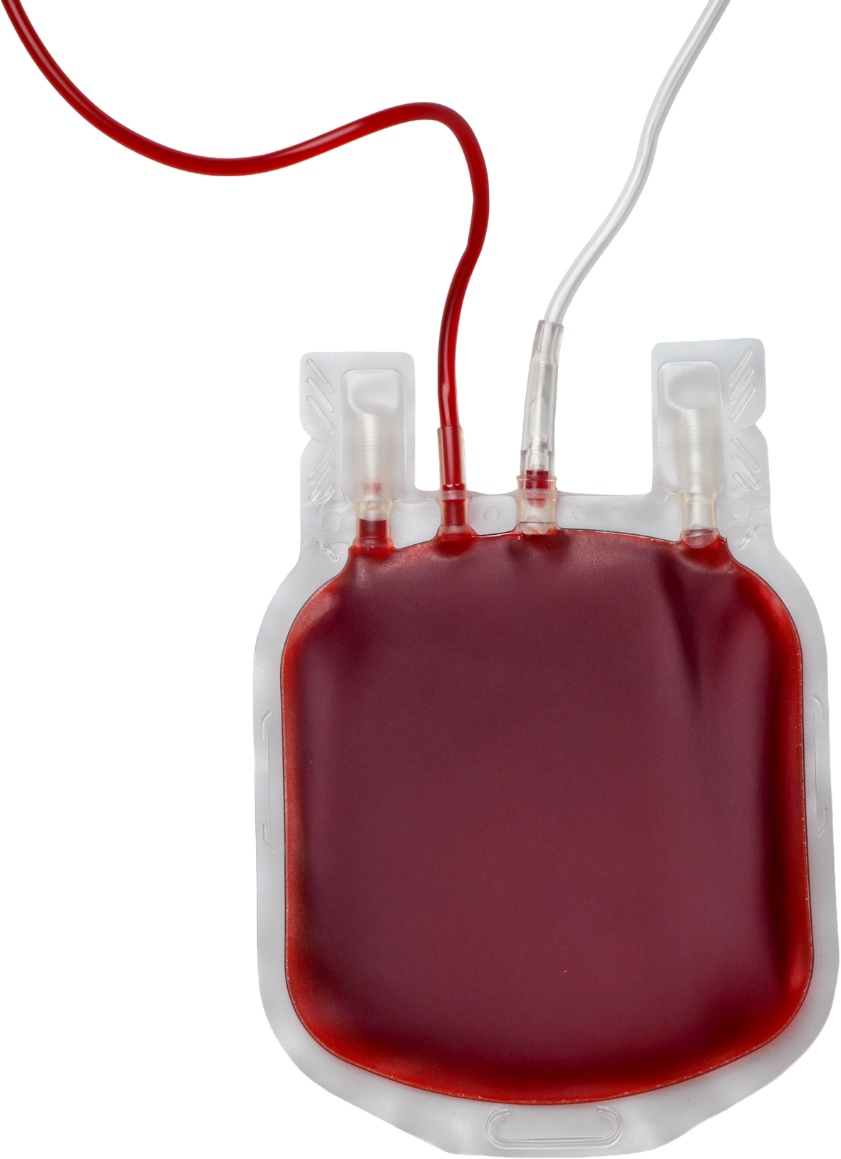
BLOOD BANK MANAGEMENT SYSTEM
SUGGULA SRI VISHNUPRIYA (2520030348)
VUNGARALA MOUKTHIKA(2520030298)

Slide 2
INTRODUCTION
  A Blood Bank Management System is a web based application designed to manage blood donors, blood groups, blood stock, and blood requests efficiently.
  It maintains accurate records of donors, recipients, blood units, and transactions.
  The system helps track the availability and expiry of blood units.
  It reduces manual paperwork and minimizes errors in maintaining blood-bank records.
  It enables quick retrieval of information during emergency blood requirements.
  The main goal is to ensure that the right blood type is available at the right time.

Slide 3
ABSTRACT
The Blood Bank Management System is a web-based application developed to simplify and organize the management of blood donors, blood stock, hospital requests, and donation activities. It provides a centralized platform for maintaining donor details and donation history, monitoring blood group availability and expiry dates, managing hospital requests, and organizing blood donation camps.
The system includes modules such as Donor Registration, Blood Stock Management, Hospital Request Management, Camp Management, Cross-Match Records, Reports, and Alerts. Cross-match records help maintain blood compatibility information before blood is issued, while alerts help staff identify important stock conditions and upcoming expiries.
The project demonstrates key DBMS concepts, including tables, primary and foreign keys, relationships, SQL queries, and structured data management. By reducing manual record-keeping and providing quick access to information, the system aims to make blood bank operations more efficient, organized, and reliable, while improving coordination between donors, blood banks, and hospitals.

Slide 4
PROBLEM STATEMENT
  Traditional blood-bank management often relies on manual records and spreadsheets, making data difficult to maintain.
  Finding the availability of a particular blood group can take considerable time.
  Manual record-keeping may result in data duplication, errors, and loss of information.
  Tracking blood donations, issued units, and available stock becomes difficult as the number of records increases.
  It is challenging to monitor blood-unit expiry dates, which can lead to wastage.
  A centralized database is required to provide fast, accurate, and reliable blood-bank information.

Slide 5
MODULES
Module | Main Functions
1. Donor Management | Donor registration, personal details, blood group, donation history and donor records
2. Blood Stock Management | Track blood groups, available units, collection dates, expiry dates and stock status
3. Hospital Request Management | Hospital registration, blood requests, request processing, approval and issue tracking
4. Blood Donation Camp Management | Create and manage donation camps, camp details, donor participation and collected units
5. Cross-Match Management | Record blood compatibility and cross-match results before issuing blood
6. Reports & Alerts | Stock reports, donor/request reports, low-stock alerts and blood expiry notifications
7. Database & Security Management | Relational database, keys and relationships, SQL operations, validation, authentication and role-based access

Slide 6
SOFTWARE DETAILS
  React.js – Used for developing the frontend and creating different pages/modules of the Blood Bank Management System.
  MySQL / SQL – Used for storing, managing, and retrieving donor, blood stock, hospital, and blood request data.
  Visual Studio Code – Used as the development environment for coding, managing, and maintaining the project.

Slide 7
CONCLUSION
  The Blood Bank Management System provides a centralized and organized way to manage donors, blood stock, hospital requests, and donations.
  It reduces manual record-keeping and errors through structured database management.
  Features like cross-matching, alerts, and reports improve blood availability and coordination.
  Overall, the system helps make blood bank operations faster, reliable, and efficient.

Slide 8
THANK YOU

